Slide 1

CPU4106 Group Project
By Carl Hunter​​ (UX/UI design – Frontend)
And
Peter Foley (DB architecture/design – Backend)
Group: K1
​Cohort: Jan25
Name of Lecturer: Musa Muhammad​
Date: 11/10/2026​
Notes:
Carl:
"Good morning, tutors and examiners. Welcome to our live viva presentation for FlyTech Energy, our peer-to-peer micro-grid renewable energy trading platform. This project was developed as a simulated industry internship at Fly-Tech, and it directly addresses UN Sustainable Development Goal 7, Affordable and Clean Energy, and Goal 12, Responsible Consumption and Production.
We are Group K1, Jan 2025 cohort. I'm Carl Hunter, responsible for UX/UI design and front-end implementation. My colleague is Peter Foley, responsible for database architecture, backend services, and project management tracking. Our module leader is Dr. Taiwo Akinmuyisitan, and this viva is delivered on 9th November 2026."

Slide 2
Executive Summary & Sustainability Goals
Addressing UN Sustainable Development Goals 7 and 12 through localized green energy exchange
SDG 7 TARGET
Affordable & Clean Energy
Enabling households with rooftop solar to share surplus generation locally at fair market pricing.
SDG 12 TARGET
Responsible Consumption
Minimizing transmission loss and wastage through direct peer-to-peer microgrid matching.
SYSTEM SCOPE
Full-Stack Architecture
Flask REST API paired with PostgreSQL triggers, automated partitioning, and vanilla JS client.
Notes:
Carl:
the problem and our system scope. Cities and local communities waste significant amounts of locally generated solar and wind energy because households lack a secure, transparent marketplace to trade surplus kilowatt-hours with neighbours.
FlyTech Energy solves this by providing a lightweight, full-stack web application where prosumers publish surplus energy, consumers purchase it at competitive market rates, and an automated ledger maintains absolute trust.
Against SDG 7, we enable households with rooftop solar to share surplus generation locally at fair market pricing. Against SDG 12, we minimise transmission loss and wastage through direct peer-to-peer micro-grid matching. The system scope is a full-stack architecture: a Flask REST API paired with PostgreSQL triggers, automated partitioning, and a vanilla JavaScript client. This alignment not just the technology is what makes the artefact a Fly-Tech client solution rather than a generic web app."

Slide 3
Project Management & Agile Scrum Workflow
Four-sprint execution tracking 119 story points across 10 structured SDLC phases
Sprint Velocity & Burndown
Sprint 1 (W1): Project Initiation & Back-End Planning (21 pts)
Risk Mitigation & Control
Sprint 2 (W2): Requirements, Backlog & Schema (28 pts
Sprint 3 (W3): API Development & DB Integration (36 pts)
Sprint 4 (W4): Front-End Integration & Testing (34 pts)
JSON Serialization: Standardized payload contract resolved in daily stand-up.
CORS Failures: Explicit server configuration resolved full-stack routing
Audit Compliance: Automated logging for every wallet movement and trade
Notes:
Peter:
"Slide 3 covers our project management approach. To deliver within our strict five-week academic window we adopted an Agile Scrum methodology across ten structured SDLC phases.
As a two-person Agile team, Carl handled UI/UX design and front-end implementation, while I managed database architecture, backend services, and sprint tracking. We structured the project across four rigorous sprint cycles totalling 119 story points:
Sprint 1, Week 1: Project initiation and backend planning 21 points.
Sprint 2, Week 2: Requirements, product backlog, and database schema 28 points.
Sprint 3, Week 3: API development and database integration 36 points.
Sprint 4, Week 4: Front-end integration and full testing 34 points.
We tracked velocity using a burndown chart against that 119-point baseline, and maintained daily stand-up notes, sprint backlog records, and a Gantt schedule all committed to our GitHub repository as auditable evidence of the Scrum process.“
Peter:
"On risk management: our framework used detailed Gantt scheduling, burndown monitoring, and daily stand-ups to track velocity and mitigate risks early. Two risks materialised and were resolved through this process: asynchronous JSON serialization issues in Sprint 3, resolved by standardising our payload contract during a stand-up, and CORS routing failures during full-stack integration in Sprint 4, resolved through explicit server configuration. Audit compliance was handled automatically — every wallet movement and trade is logged by trigger. Proactive risk tracking is documented in our sprint logs."

Slide 4
System Analysis: Use Case Architecture
Distinct actor roles and automated background routines mapped in UML
CONSUMER
Market Access
Energy Generation
Publish surplus energy listings, monitor home battery levels, review sales earnings.
MUNICIPAL ADMIN
Governance
Browse available listings, purchase energy credits, manage digital wallet balances, view history.
PROSUMER
Manage user accounts, set tariff caps, review grid overview dashboards, calibrate smart meters.
Notes:
Peter:
"Slide 4 summarises our system analysis using UML use-case architecture. We identified three distinct actor roles with clear separation of concerns:
The Consumer has market access browsing available listings, purchasing energy credits, managing digital wallet balances, and viewing transaction history.
The Prosumer handles energy generation publishing surplus energy listings, monitoring home battery levels, and reviewing sales earnings.
The Municipal Admin provides governance managing user accounts, setting tariff caps, reviewing grid overview dashboards, and calibrating smart meters.
Alongside these actors, we mapped automated background routines the triggers and stored functions that execute without human intervention. This actor model directly drove our role-based navigation, wallet permissions, and database validation rules, so the UML analysis in Slide 4 is the design foundation for the backend constraints you'll see later.“

Slide 5
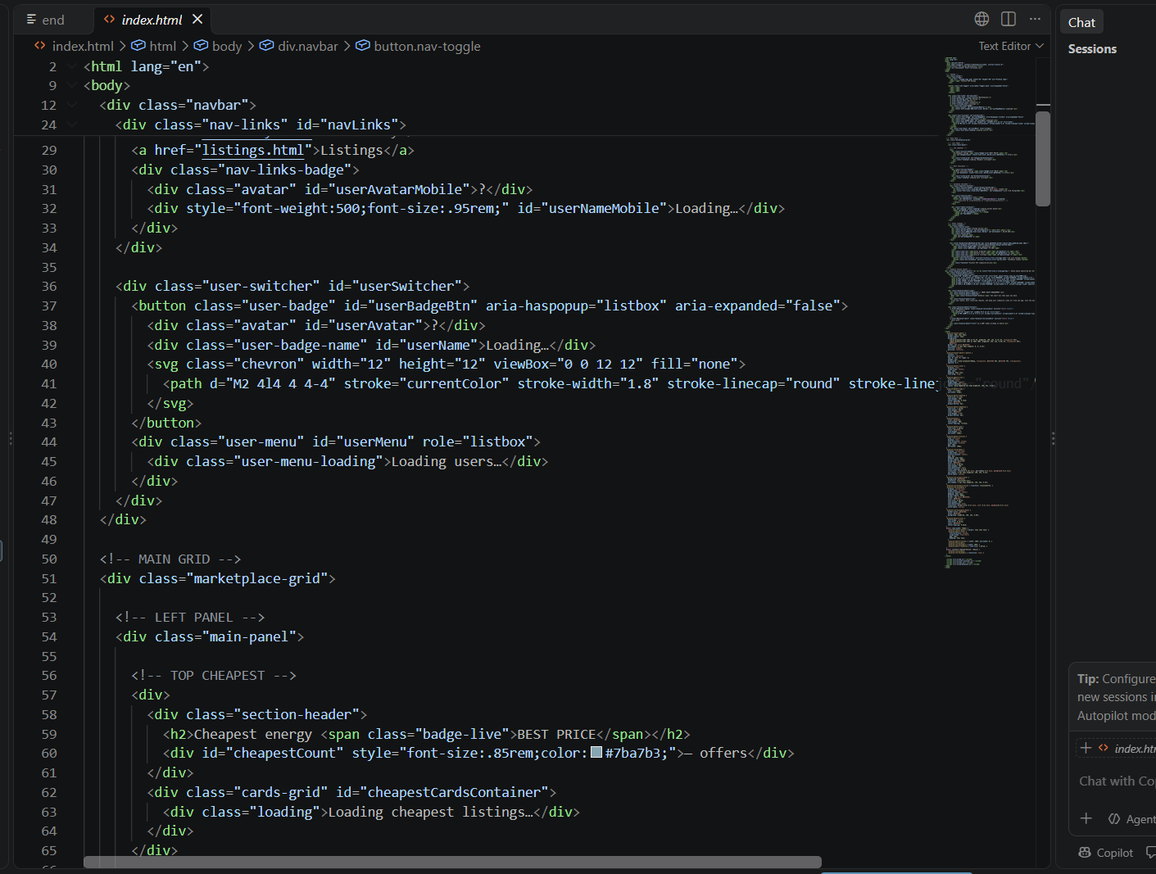
Frontend Architecture & UI Design
Responsive, component-driven client built with HTML5, CSS3, and Vanilla JavaScript
Design Principles
Modular Navigation: Unified responsive navbar across all views with live user badge.
Interactive Marketplace: Dynamic filtering for cheapest energy and bulk generation offers.
Real-Time Sync: Client-side state updates instantly reflect database transaction triggers.
Accessibility & Contrast: WCAG 2.1 AA compliant dark teal theme (#0B2327 & #2EC4B6).
Notes:
Carl:
"Turning to the front-end architecture. My objective was to build an intuitive, accessible, and responsive user interface aligned with WCAG 2.1 AA accessibility standards and our professional dark teal palette a base of #0B2327 with #2EC4B6 accents, chosen for contrast compliance.
We started by wireframing user journeys in Penpot, establishing clear pathways for the three core user roles: Consumers, Prosumers, and Municipal Administrators. The design principles were modular navigation a unified responsive navbar across all views with a live user badge; an interactive marketplace with dynamic filtering for cheapest energy and bulk generation offers; and real-time sync, where client-side state updates instantly reflect database transaction triggers."

Slide 6
Frontend Feature: Marketplace & Listing Management
Seamless P2P energy discovery and instant publication
MART FILTERING
Listing Creation
NTERACTIVE ACTIONS
Instant Purchase
ROSUMER CONTROL
One-click buying triggers atomic backend fund transfers and listing status updates.
Best Price & Bulk
Listings automatically sorted by cost-per-kWh or total available kilowatt-hours.
Form validation enforcing positive energy amounts, pricing caps, and expiry dates.
Notes:
Carl:
"Slide 6 shows the core interfaces. The Marketplace, index.html, displays real-time energy listings sorted by cheapest price or bulk availability. Users can inspect live supplier profiles, view token pricing, and execute secure purchases with one-click buying that triggers atomic backend fund transfers and listing status updates.
My Energy, my-energy.html, allows prosumers to track solar generation telemetry, monitor battery storage levels from 0 to 100 percent, and review active listings. The listing creation form enforces validation positive energy amounts, pricing caps, and expiry dates before anything reaches the backend.
Wallet Management, wallet.html, provides users with clear visibility over their fiat and token balances, fiat-to-crypto conversion rates in pounds and USD, and complete trade histories with dynamic filtering. Balances update in real time as trades settle."

Slide 7
Frontend Feature: Wallet & Energy Analytics
Transparent financial tracking and solar telemetry visualisation
Energy Wallet
Generation Monitoring
Tracks solar generation logs, battery storage levels (%), monthly revenue, and community prosumer leaderboards.
Displays live balances in local tokens (£) with automatic USD conversion, top-up simulation, and complete transaction histories.
Notes:
Carl:
"Slide 7 covers community and transparency. Community, community.html, features community member directories, a live sales leaderboard ranking top prosumers by kilowatt-hours sold, and an auditable system event log visible to users reinforcing the transparency principle behind SDG 12.
From a technical standpoint, the front-end was built using vanilla HTML5, modular CSS3, and asynchronous JavaScript using the fetch API to communicate seamlessly with our backend REST endpoints without page reloads. We deliberately chose a lightweight footprint no heavy framework consistent with the responsible-consumption ethos of the project and appropriate to our Level 4 scope."

Slide 8

ARCHITECTURE SHIFT
Transitioning to Back-End Engineering
Moving from client-side user experience down to relational database design, ACID compliance, triggers, and secure API endpoints.
Notes:
Peter:
"Thank you, Carl. Moving from client-side user experience down to relational database design, ACID compliance, triggers, and secure API endpoints.
While Carl focused on the user experience, my focus as backend developer was ensuring rock-solid data integrity, concurrency control, and transactional safety using Python Flask and a fully normalised PostgreSQL relational database. We chose PostgreSQL specifically because triggers, row-level locking, and declarative partitioning let us enforce ACID guarantees at the storage layer a deliberate architectural decision for financial integrity."

Slide 9
Backend Architecture: Relational Database Schema
Six core relations with rigorous foreign key constraints and referential integrity
Table Name | Primary Key | Foreign Keys & Constraints | Purpose
users | user_id (Serial) | UNIQUE email, meter_serial_no | Manages Consumers, Prosumers, and Municipal Admins.
user_wallets | wallet_id (Serial) | user_id (ON DELETE CASCADE) | Stores digital currency balance (1:1 with users).
energy_listings | listing_id (Serial) | prosumer_id → users | Active surplus energy offers with CHECK constraints.
transactions | transaction_id (Serial) | listing_id, consumer_id | Immutable ledger of completed energy trades.
audit_logs | audit_id (Serial) | user_id (ON DELETE SET NULL) | Tracks system security events, trades, and wallet changes.
generation_logs | (log_id, recorded_date) | user_id → users | Partitioned time-series telemetry for solar output & battery.
Notes:
Peter:
"Slide 9 presents our schema: six core relational tables linked by strict foreign keys with explicit cascade and restriction rules:
users manages account details, roles as Prosumer, Consumer, or Municipal Admin, and unique smart meter serial numbers.
user_wallets enforces a 1:1 relationship with users via a unique index and ON DELETE CASCADE, storing digital currency balance.
energy_listings stores surplus energy offers with CHECK constraints ensuring positive kWh amounts and prices.
transactions an immutable ledger recording completed trades, linking buyer and listing through foreign keys.
generation_logs our time-series telemetry, partitioned declaratively by range on recorded_date into monthly partitions _2026_10, _2026_11, and _default for high-performance querying.
audit_logs captures an immutable trail of security events, wallet deposits, withdrawals, and trade completions, with ON DELETE SET NULL on the user reference so audit history survives account deletion.
This normalisation and referential integrity is the backbone that makes every trigger on the following slides safe."

Slide 10
Advanced Database Design: Partitioning & Indexing
Optimizing high-frequency time-series telemetry and query performance
ANGE PARTITIONING
Row-Level Locking
PARTIAL INDEXING
SELECT ... FOR UPDATE` locks listing rows during purchase v-spending races.
Generation_logs
Declaratively partitioned by RANGE(recorded_date) into monthly tables (_2026_10, _2026_11, _default) for efficient I/O.
CONCURRENCY GUARD
Meter Numbers
CREATE UNIQUE INDEX users_meter_key ON users(meter_serial_no) WHERE meter_serial_no IS NOT NULL;`
Notes:
Peter:
"Slide 10 covers advanced design. Range partitioning on generation_logs isolates monthly telemetry for efficient I/O — queries touch only the relevant partition.
Partial indexing optimises the meter serial lookup: we created a unique index on users(meter_serial_no) only where meter_serial_no IS NOT NULL, allowing users without a registered meter while guaranteeing uniqueness for those who have one.
And our concurrency guard: when a trade occurs, trg_check_listing_available performs row-level locking with SELECT … FOR UPDATE, preventing race conditions where two users attempt to purchase the same energy simultaneously. Combined, these three techniques keep a high-frequency time-series workload performant and financially safe."

Slide 11
Database Triggers & Automated Safety Rules
Centralizing critical business rules directly in PostgreSQL for bulletproof consistency
Trigger Name | Timing & Event | Associated Function | Business Logic Enforced
trg_check_listing_available | BEFORE INSERT | fn_check_listing_available() | Locks listing row and rejects purchase if status is not 'Available'.
trg_no_self_purchase | BEFORE INSERT | fn_no_self_purchase() | Blocks prosumers from purchasing their own energy listings.
trg_update_wallet | AFTER INSERT | fn_transaction_wallet_update() | Atomically debits buyer wallet and credits seller wallet.
trg_listing_autocomplete | AFTER INSERT | fn_listing_complete_on_txn() | Automatically updates listing status to 'Completed' upon trade.
trg_prevent_user_delete | BEFORE DELETE | fn_prevent_user_delete...() | Prevents deletion of users who have active listings in the market.
Notes:
Peter:
"Slide 11 is the heart of our backend: rather than relying solely on application-level code, we encapsulated critical business logic directly inside database triggers and stored functions in PostgreSQL. Five triggers enforce the rules:
trg_check_listing_available BEFORE INSERT locks the listing row and rejects purchase if the status is not 'Available'.
trg_no_self_purchase BEFORE INSERT verifies a prosumer cannot purchase their own energy listing.
trg_update_wallet AFTER INSERT performs the atomic financial transfer: verifying buyer funds, debiting the consumer's wallet, and crediting the prosumer's wallet instantly. It also writes detailed event records to audit_logs whenever balances change, guaranteeing complete regulatory transparency.
trg_listing_autocomplete AFTER INSERT automatically updates the listing status to 'Completed' upon trade, closing the offer the instant it's sold.
trg_prevent_user_delete BEFORE DELETE strictly blocks deletion of any user who has active listings in the market, protecting open offers.
Together these enforce referential and market integrity at the database layer, not the application layer meaning even direct API abuse cannot corrupt the ledger."

Slide 12
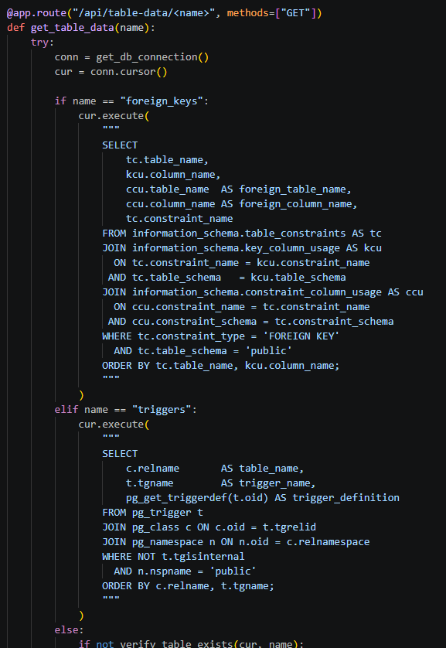
Backend API Architecture (Python Flask)
RESTful endpoints ensuring secure parameterised queries and robust error handling
Key Endpoints & Operations
GET /api/table-data/: Dynamic schema explorer and table fetcher.
POST /api/table-data/energy_listings: Validates and publishes prosumer energy offers.
POST /api/table-data/transactions: Executes secure trade transactions triggering wallet settlement.
SQL Injection Prevention: Strict use of parameterised queries across all DB adapters.
Notes:
Peter:
"Slide 12 shows our Flask REST API architecture. Endpoints are deliberately thin they ensure secure parameterised queries and robust error handling, while delegating business logic to the triggers:
GET /api/table-data/ a dynamic schema explorer and table fetcher.
POST /api/table-data/energy_listings validates and publishes prosumer energy offers.
POST /api/table-data/transactions executes secure trade transactions, triggering wallet settlement via trg_update_wallet.
Critically, we use strict parameterised queries across all database adapters, eliminating SQL injection risk. This API layer is exactly where Carl's fetch calls meet the database the integration point that Sprint 4 tested end-to-end."

Slide 13
System Testing & Verification
Rigorous validation across unit functions, database boundaries, and end-to-end user flows
SECURITY TESTING
Insufficient Funds
NTEGRATION TESTING
CORS & Endpoints
INANCIAL INTEGRITY
Validated full-stack communication between JavaScript client and Flask backend without routing errors.
Self-Trade Prevention
Verified that trg_no_self_purchase successfully blocks users from buying their own listed energy
Tested wallet debit limits; transactions roll back atomically if buyer balance is below total cost.
Notes:
Carl:
"Integrating our systems during Sprint 4 brought typical real-world development challenges. We encountered CORS policy restrictions and asynchronous JSON serialization mismatches when the browser dispatched requests to the Flask server.
By standardising our JSON payload contracts during daily stand-ups and configuring explicit CORS headers on the backend, we successfully established robust end-to-end communication. This is exactly the kind of issue that our daily stand-up process was designed to surface quickly.“
Peter:
"We validated the system through comprehensive unit, integration, and end-to-end testing. Test cases verified that:
Self-trade prevention trg_no_self_purchase successfully blocks users from buying their own listed energy.
Financial integrity insufficient wallet balances correctly trigger exceptions and roll back database transactions atomically; the buyer is never debited below zero.
Expired listings automatically downgraded to 'Expired' via a BEFORE UPDATE trigger on listing expiry before any update executes.
Referential protection deleting a user with active listings is strictly blocked by trg_prevent_user_delete.
Integration CORS and endpoints validated full-stack communication between the JavaScript client and Flask backend without routing errors.
All test results, bug fixes,
Check this peter
and git commit histories were maintained transparently on our GitHub repository throughout the project which also holds our stand-up records, backlog, and burndown evidence."

Slide 14
Conclusion & Future Scope
Demonstrating that an undergraduate team can deliver an enterprise-grade microgrid platform
Project Achievements
Future Roadmap
Integration of physical IoT smart meters for automated telemetry, blockchain-backed audit settlement, and multi-user concurrent load testing.
Successfully delivered a functional P2P renewable energy trading platform adhering to Agile Scrum, robust PostgreSQL database engineering, and clean UI design.
Notes:
Carl:
"In conclusion, FlyTech Energy successfully demonstrates that a small, disciplined Level 4 team operating as a two-person Agile team with explicit front-end and back-end ownership can deliver a fully functional, SDG-aligned computing artefact within a tight timeframe by adhering strictly to Agile principles and robust software engineering methodologies.
We delivered a working peer-to-peer renewable energy trading platform: a Flask REST API, a normalised PostgreSQL database with partitioning and five enforcing triggers, a WCAG 2.1 AA accessible vanilla JavaScript client, and comprehensive test evidence all tracked across four sprints and 119 story points.“
Peter:
"While our current prototype successfully handles the core trading loop, future work will focus on three enhancements: integrating real IoT smart-meter hardware for automated telemetry ingestion into generation_logs; implementing blockchain-backed settlement for tamper-proof auditing beyond our current audit_logs; and conducting concurrent multi-user load testing to validate performance under realistic marketplace traffic."

Slide 15


Thank You & Open for Questions
GitHub Repository: FlyTech-P2P-Energy
Live Demo Ready
FlyTech Energy • Empowering Sustainable Communities through P2P Trading
Notes:
Carl:
"Thank you for listening. [Turn to screen — launch demo] Before we open the floor, we'd like to demonstrate the system end-to-end: publishing a listing as a Prosumer, purchasing it as a Consumer, and showing the wallet balances and audit log updating atomically in real time through the database triggers."
[Run 60–90 second live demo: Prosumer publishes listing → Consumer buys → show wallet debit/credit + audit_log entry + listing status 'Completed’]
Peter:
"We are now delighted to open the floor to your questions and examiners' defence."

